Slide 1
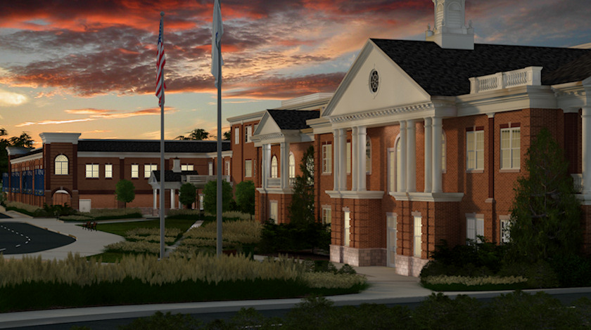

Slide 2
Plymouth North
High School
School Improvement Plan
2022-2025
2024 Plan Update

Slide 3
SIP GOALS: PNHS 2022-2025 &
Strategic Plan Alignment
PNHS SIP GOALS 2022-2025:
IDENTIFY AND IMPLEMENT TRANSITION GOALS: Develop school-wide transition goals for each grade and post-hs that will allow for learning growth academically, personally and socially.
REACH ALL STUDENTS: Develop opportunities for increased equity, access & voice for all our students with different learning and personal backgrounds so they can reach their full potential.
INCREASE STUDENT ENGAGEMENT: Develop common strategies, programs and plans to help re-engage our students with school culture, academics and emotional supports to feel safe in taking risks to enhance their high school experience and improve their learning growth.
PPS STRATEGIC PLAN 2022-2025:
ACADEMIC ACHIEVEMENT: Improve the outcomes of all learners through an inclusive and equitable education.
SOCIAL EMOTIONAL WELLNESS: Develop and implement a network of social and emotional support for all learners
FAMILY & COMMUNITY ENGAGEMENT: Engage all stakeholders to support the success of all students.
EQUITY, DIVERSITY, INCLUSION & BELONGING: Create and support a Learning Community that recognizes and embraces diversity and talents of all people.

Slide 4
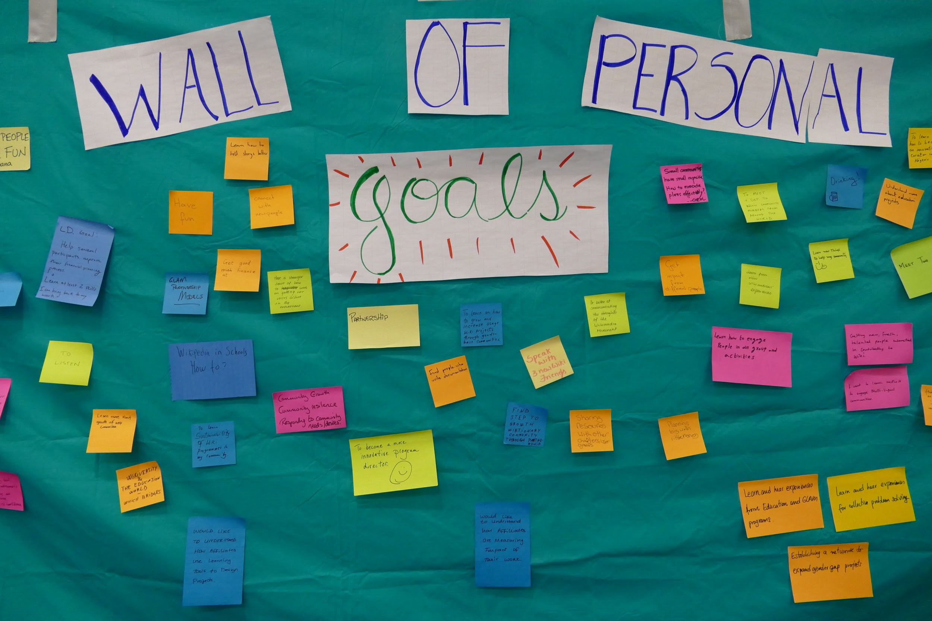
Goal 1: Identify & Implement Transition Goals
Developing a PNHS Vision for Graduates founded in a Growth Mindset
Action Steps 2022-2025:
Review and Refine Freshman Academy Transition Goals:
  Review “Deep Thinking”, “Self-Advocacy” and “Organization” as Freshman Goals
  Enhance and Refine Progress Reports, Programs and Policies
Develop Goals and Programs around Transition Goals for Grades 10-12.
Create a common template that links transition goal skills with every department, course and unit at PNHS to publicize to parents
Develop a school wide vision for our graduates that ties into an Advisory Program
Create a 4-year capstone program that allows students to self-reflect on Mastery, Identity, Creativity and growth on Transition Goals each year.
Key Input on Setting this Goal:
Review and Modify the Core Values, Beliefs & Learning Expectations based on your Vision of the Graduate based on research and multiple data sources
-NEASC Report Recommendation
47.5% of Parents in our Survey believe PNHS focuses on Learning Growth over Work Production.

Slide 5
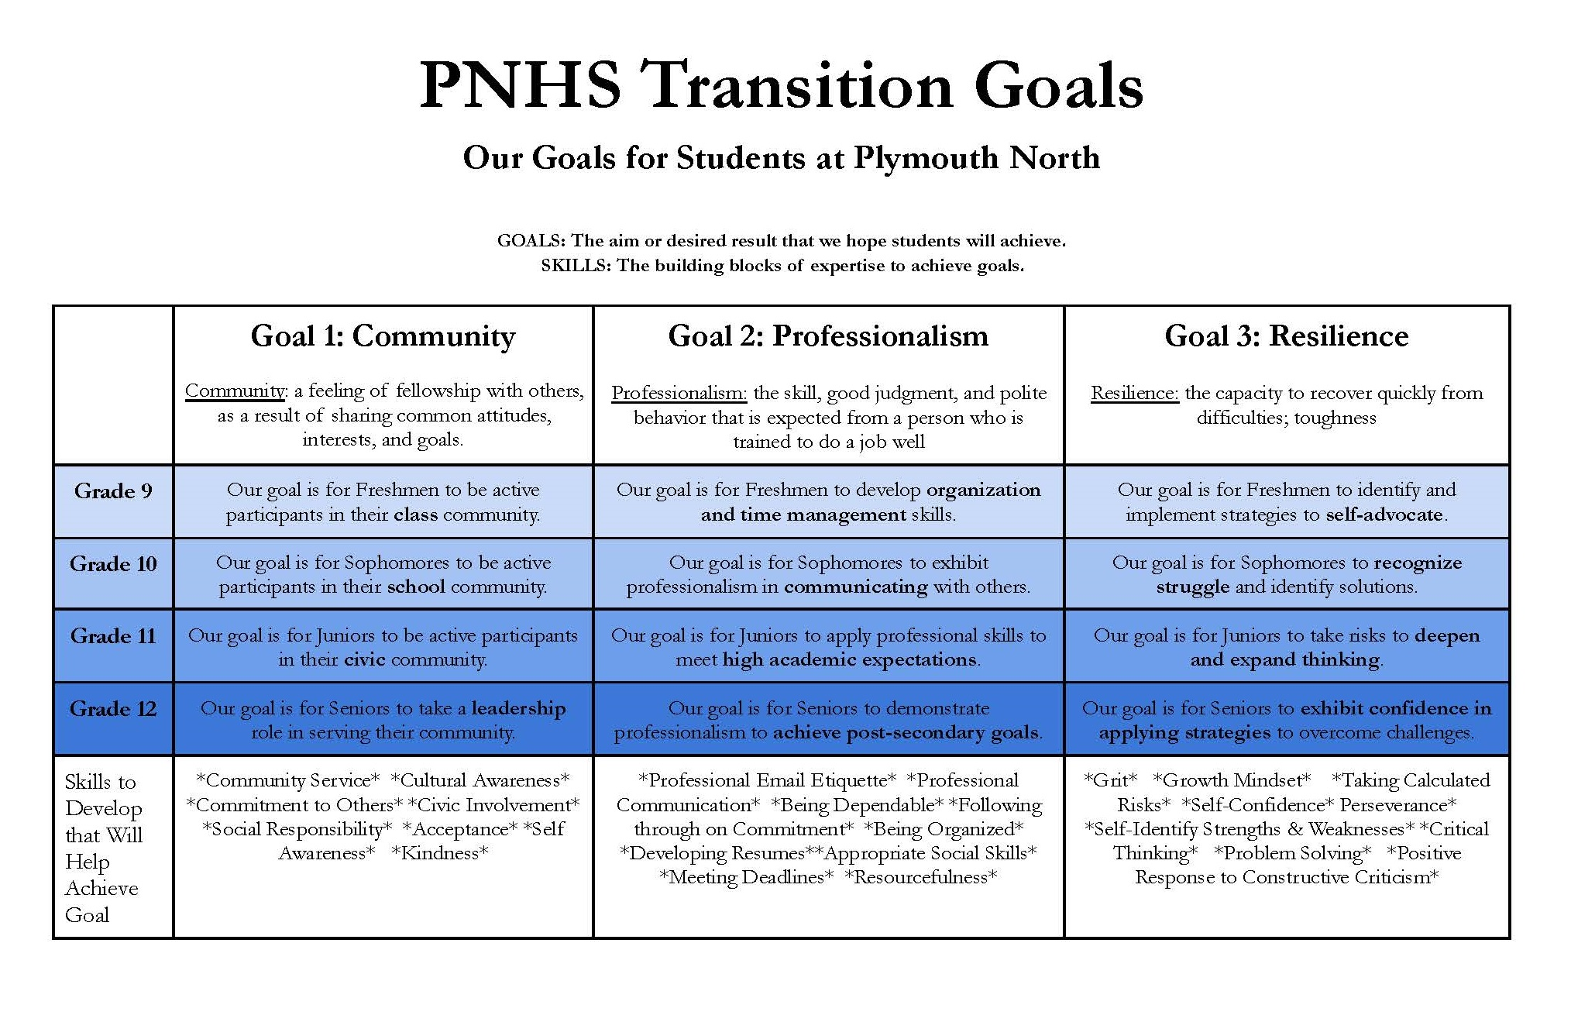
2023-2024: Goal Development & Implementation:
COMMUNITY, PROFESSIONALISM, RESILIENCE

Slide 6
Year Two: Initial Lessons School Wide
Publish Goals: Craft and Publish School-Wide document outlining which transition goals are incorporated into every unit of every course in every department.
Initial Lessons for Students: Begin to identify curriculum, lessons and plans to implement an Advisory curriculum that teaches and assesses student growth on Transition Goals of “Community”, “Professionalism” and “Resilience”. Freshman Advisory & Advisory Visits.

Slide 7
Year Three: Lessons School Wide
Redesign Advisory for Transition Goal Lessons: Begin to identify curriculum, lessons and plans to implement an Advisory curriculum that teaches and assesses student growth on Transition Goals of “Community”, “Professionalism” and “Resilience”. Model sample lessons for feedback and review.
Senior Capstone Reflection: Design and Implement Capstone Activity for Seniors to reflect on and express growth on transition goals during their high school career & apply to real-world learning.

Slide 8
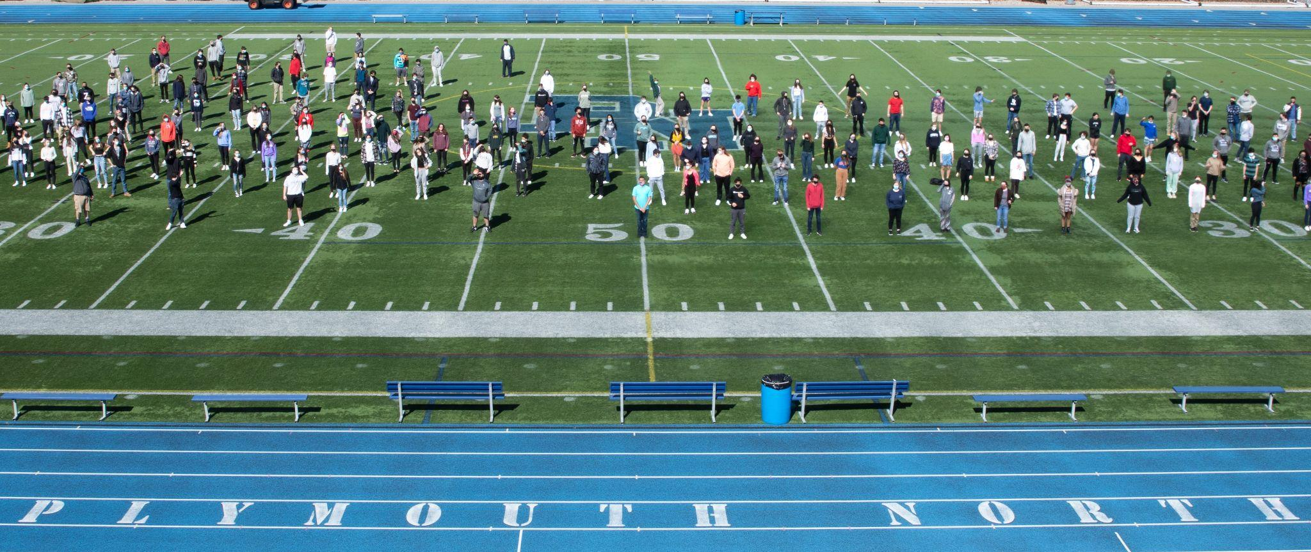
Goal 2: Reach ALL Students
Inclusion, Equity for Diverse Students & Learning Growth at ALL levels
Action Steps 2022-2025:
Create formal and informal opportunities to review data to identify trends that will support students at-risk.
Implement new programs to allow increased access and voice for diverse students.
Use data and input to develop targeted formal programs specifically designed to help support underperforming student subgroups to improve learning growth.
Find resources, provide professional development and implement strategies school-wide to help improve our curriculum, policies and instruction for students at all learning levels.
Develop programs and opportunities for teacher collaboration to improve learning growth for CP1 and CP2 level students to help them thrive at PNHS.
Key Input on Setting this Goal:
Ensure that teachers adjust their instructional practices to meet the needs of each student… strategically differentiating, purposefully organizing group activities and providing additional support and alternative strategies -NEASC Report Recommendation
39% of Parents in our Survey believe PNHS is aware of their children’s unique talents and achievement, and 31% are undecided.

Slide 9
2023-2024: Expand Student Voice and Data Team
GOAL ACTION
Create formal and informal opportunities to review data to identify trends that will support students at-risk. Implement new programs to allow increased access and voice for diverse students.
Expand the Equity and Justice Committee to provide faculty advisor Common Planning Time during K Block and provide student volunteers in-school meeting time to join
Find resources, provide professional development and implement strategies school-wide to help improve our curriculum, policies and instruction for students at all learning levels.
New systems for regular review of school wide data weekly, monthly & term based by DHs and Administrator for trends. Increased involvement of students during school time for voice and input of perspective. Training and development for teacher-led data team.
THANK YOU BRITTANY, TONY & KELSEY! Provide planning and development time for key staff members running the Equity and Justice committee weekly via K Block. Allow committee leaders to expand meetings to include student volunteers during K Block meetings as a school club for Equity and Justice.
Faculty-wide professional development offerings reviewing Special Ed and EL processes, providing Special Ed and EL strategies to use building wide and opportunities for cross-department conversations on best practices. Faculty-wide PD session in inclusive practices and improving perspective on the diversity of students at PNHS.

Slide 10
Year Three: Programs to reach all students
Improve & Implement Policy based on Formal Data Team Feedback: Implement building wide strategies and programs to review scheduling, practices and policies based on data trends.
School-Wide Program to Improve Inclusion and School Experience: Implement student-led school-wide workshops or experience to provide perspective on diverse students and inclusive practices for all students and staff.
Identify & Implement Inclusive Practices: Implement specific practices and strategies that particularly respond to issues raised in data and feedback that improve instruction, culture, learning growth and inclusion.

Slide 11

Goal 3: Increase Student Engagement
Getting Back to Deeper Learning and Social/Emotional Success
Action Steps 2022-2025:
Review and Redesign our school wide beliefs and our vision for what our graduates will be, codify that set of beliefs and broadcast them.
Work to implement programs and adjust strategies and protocols to help re-engage students with expectations of a typical academic school year.
Provide increase social/emotional and mental health supports in our resources, staff and schedule to improve student success.
Develop programs and strategies for improved school attendance, extra-curricular engagement and grit.
Allow for collaborative time for teachers to improve engagement in their classes and with the content in their course around mastery, identity & creativity.
Key Input on Setting this Goal:
Use the school’s core values, beliefs and learning expectations to drive the school’s curriculum, instruction and assessment in every classroom and to guide the school’s policies, procedures, decisions and resource allocations. -NEASC Report Recommendation
Mental Health (#1) & Academic Support (#2) were the most common post-pandemic needs noted in the 2022 Parent Survey

Slide 12
Year Two: Increase Student Engagement
Engagement Continuum: Implement PD and Practices around the three tenets of “Engagement Continuum” to help support planning and instruction to move students from “Participation” in to “Driving” their learning.
Peer Observations: Create formal opportunities for teachers to conduct peer observation of each other’s classroom with guided post observation feedback and collaboration time.
Formative Assessment: PD, Practices and Strategies that create a building culture of developing formative assessment and using that data in crafting and revising lessons to improve our instruction to meet the needs of student learning growth

Slide 13
Year Three: Planning & Collaboration
Use of Formative Assessment in Lesson Planning: PD, Collaborative time and PLC time focused on using Formative Assessment data in lesson planning to improve engagement and improve learning growth.
Team Tours: Expansion of formal, scheduled, non-evaluative tours of classrooms with cross-disciplinary administrators, department heads and teachers to create common understanding of school-wide learning expectations, facilitate discussions on trends in teaching and learning, and share best practices across departments to improve student engagement and learning growth.

Slide 14
PNHS Implementation March, 2024 - March, 2025
This Year’s Action Plan:
GOAL 1: IDENTIFY AND IMPLEMENT TRANSITION GOALS:
Publish Transition Goals: Community, Professionalism & Resilience and course connections.
Create Advisory Lessons to teach skills to build Transition Goal achievement
Begin to develop Senior Capstone on reflection of goals and personal growth
GOAL 2: REACH ALL STUDENTS:
Develop Data Team findings and possible solutions to implement targeted programs to support at-risk students
School-Wide Program for all staff and students to improve inclusive culture
Develop in-school programs to provide voice to improve access to learning and culture for diverse and at-risk students
GOAL 3: INCREASE STUDENT ENGAGEMENT:
Expand Team Tours to create consistency and share best practices around improved engagement and learning growth
Implement common building-wide strategies for using formative assessment and using the data to improve instruction

Slide 15
Developing a PNHS where:
Students personalize their learning.
Students reflect formally both on content growth AND personal growth.
ALL students feel a sense of belonging and at home at PNHS.
Every type and level of learner believes they can succeed and achieve more than they did yesterday.
Our students have the supports and resources to fully engage with a well rounded high school experience.

